Slide 1


Convolution NN (CNN)
Deep Learning
Course

Slide 2
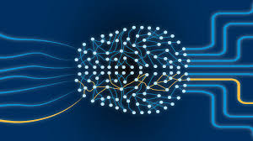

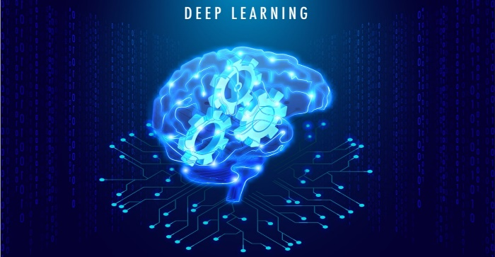
PRESENTATION
Content List
₀₁ CNN
₀₂ Padding In RGB
₀₃ Pooling Layer
04 Flatten Layer

Slide 3

01
Image
Computers Sees An Input Image As an Array Of Pixels, And It Depends On The Image Resolution.
It Will See
H * W * D
( H = Height, W = Width, D = Dimension ).

Slide 4
02
ConvolutionNeuralNetwork
CNNs are designed for working with two-dimensional image data, and they can
It can be used with one-dimensional and three-dimensional data.

Slide 5
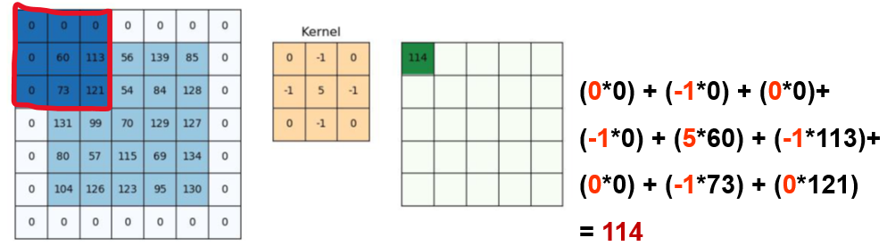
02
Convoluion layer
• Convolution is the first layer to extract features from an input image.
• Convolution keeps the relationship between pixels by learning image features using small squares of input data.
• It is a mathematical operation that takes two inputs, such as an image matrix and a filter or kernel.
Contains:
• Padding
• Stride
• Activation Function

Slide 6
03
Padding in RGB

Slide 7
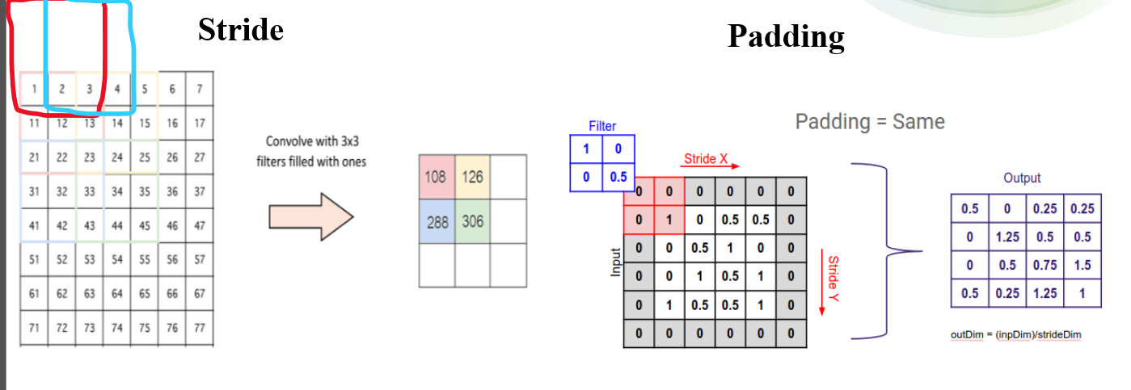
03
Convolution Layers

Slide 8
03
Convolution Layers

Slide 9
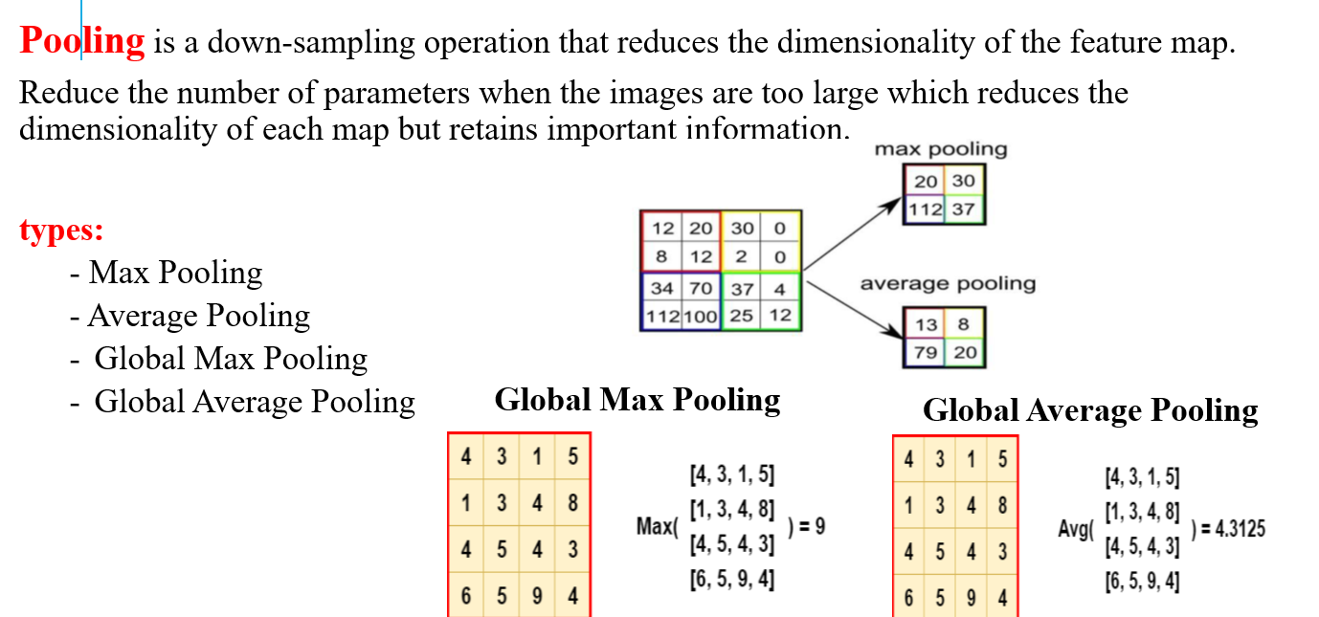
03
Pooling Layer

Slide 10
03
Flatten Layer

Slide 11
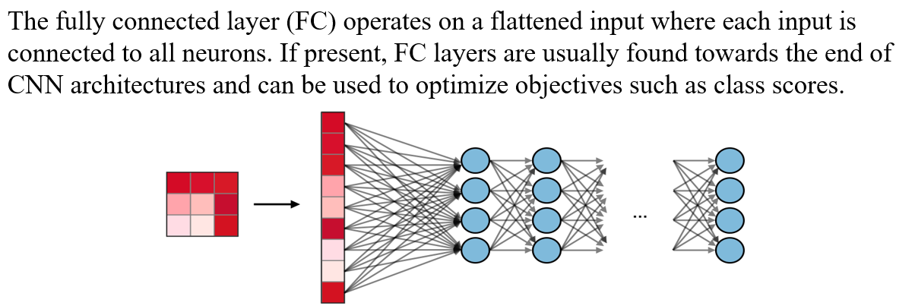
03
Fully connected layer

Slide 12
Thank You…!
End

